Slide 1

Apparent and Absolute Magnitude
Senior Theory, NUSH Astro 2022

Slide 2
Magnitude = Size?
According to ancient astronomers, yes!
Brightness ∝ Size, they believed
Hipparchus came along:
Classified stars according to brightness
Brightest Stars: “Stars of the First Magnitude”
Unclear, Barely Visible Stars: “Stars of the Sixth Magnitude”
But but but this was an arbitrary and subjective classification: oops

Slide 3
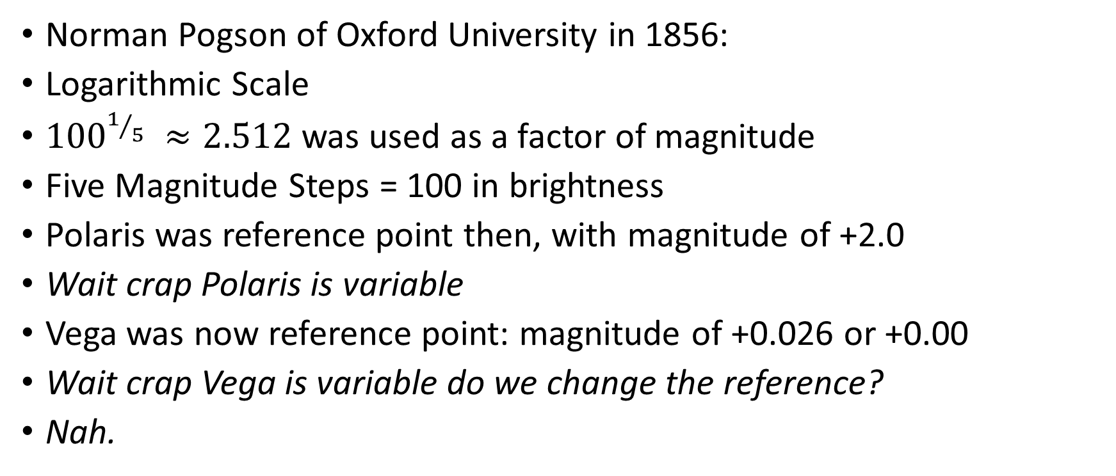
Pog-Son
Norman Pogson of Oxford University in 1856:
Logarithmic Scale
${100}^{1/5} ≈2.512$ was used as a factor of magnitude
Five Magnitude Steps = 100 in brightness
Polaris was reference point then, with magnitude of +2.0
Wait crap Polaris is variable
Vega was now reference point: magnitude of +0.026 or +0.00
Wait crap Vega is variable do we change the reference?
Nah.

Slide 4
Apparent Magnitude of Common Objects?
Object | Magnitude
Sun | -26.7 (VERY LOW)
Full Moon | -12.9 (Quite Low)
Venus (when brightest) | -4.9
Sirius (brightest star) | -1.5
Vega (reference) | +0.0
Faintest Star Visible to naked eye | +6.0

Slide 5
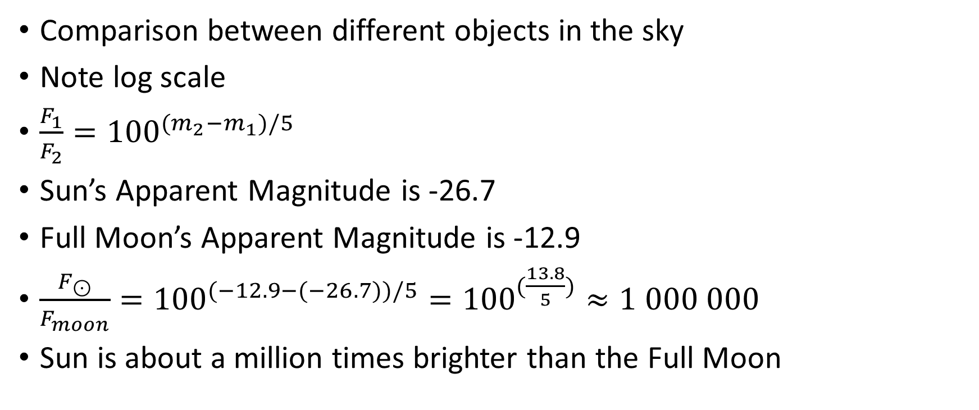
Pogson’s Law
Comparison between different objects in the sky
Note log scale
$\frac{F_{1}}{F_{2}}={100}^{(m_{2}−m_{1})/5}$
Sun’s Apparent Magnitude is -26.7
Full Moon’s Apparent Magnitude is -12.9
$\frac{F_{⊙}}{F_{moon}}={100}^{(−12.9−(−26.7))/5}={100}^{(\frac{13.8}{5})}≈1 000 000$
Sun is about a million times brighter than the Full Moon

Slide 6
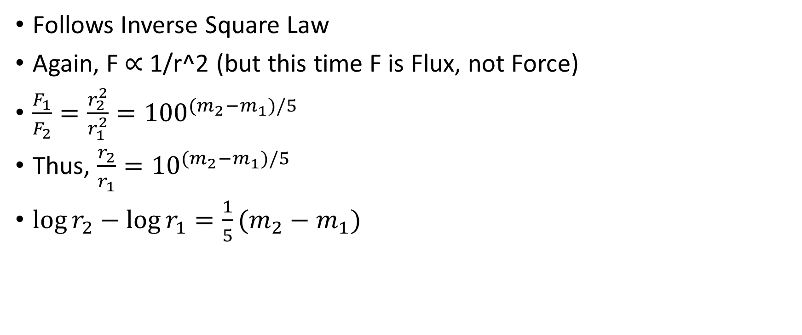
Distance and Brightness
Follows Inverse Square Law
Again, F ∝ 1/r^2 (but this time F is Flux, not Force)
$\frac{F_{1}}{F_{2}}=\frac{r_{2}^{2}}{r_{1}^{2}}={100}^{(m_{2}−m_{1})/5}$
Thus, $\frac{r_{2}}{r_{1}}={10}^{(m_{2}−m_{1})/5}$
$\log{r_{2}−\log{r_{1}=\frac{1}{5}(m_{2}−m_{1})}}$

Slide 7
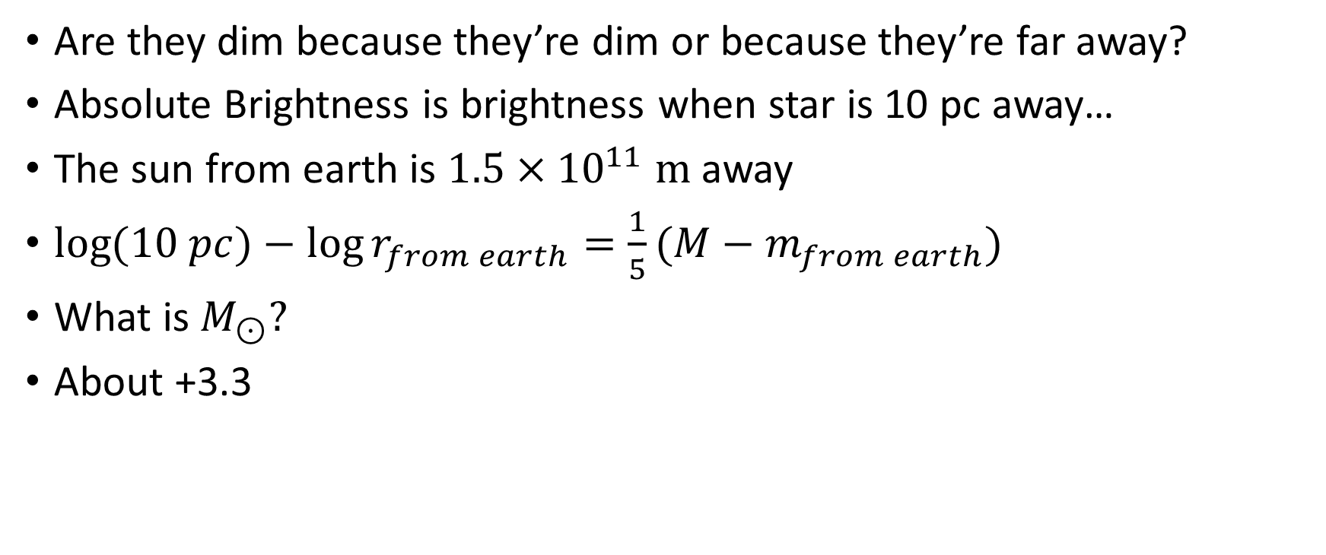
Absolute Magnitude
Are they dim because they’re dim or because they’re far away?
Absolute Brightness is brightness when star is 10 pc away…
The sun from earth is $1.5×{10}^{11} m$ away
$\log{(10 pc)−\log{r_{from earth}=\frac{1}{5}(M−m_{from earth})}}$
What is $M_{⊙}?$
About +3.3

Slide 8
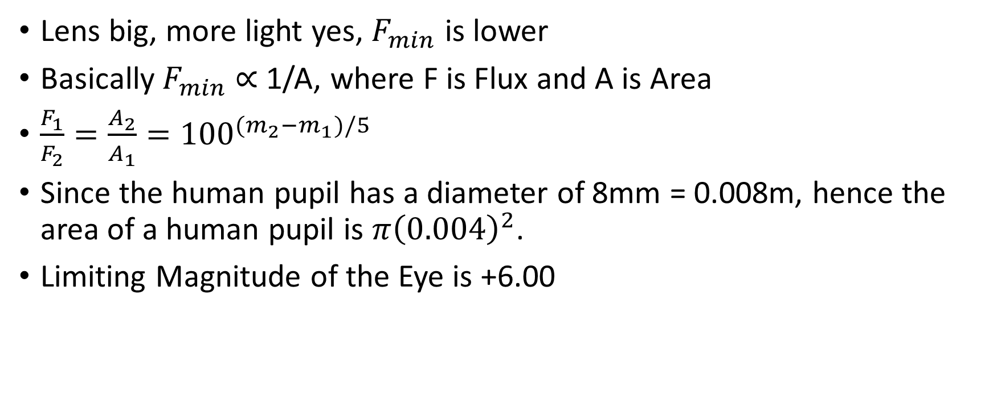
Limiting Magnitude
Lens big, more light yes, $F_{min}$ is lower
Basically $F_{min}$∝ 1/A, where F is Flux and A is Area
$\frac{F_{1}}{F_{2}}=\frac{A_{2}}{A_{1}}={100}^{(m_{2}−m_{1})/5}$
Since the human pupil has a diameter of 8mm = 0.008m, hence the area of a human pupil is $π{\left(0.004\right)}^{2}$.
Limiting Magnitude of the Eye is +6.00

Slide 9

Limiting Magnitude
Notably, we can assume the lens is circular, hence we can have a variable d to denote the diameter
Basically $F_{min}$∝ 1/d^2, where F is Flux and d is a diameter
Wing it

